Slide 1
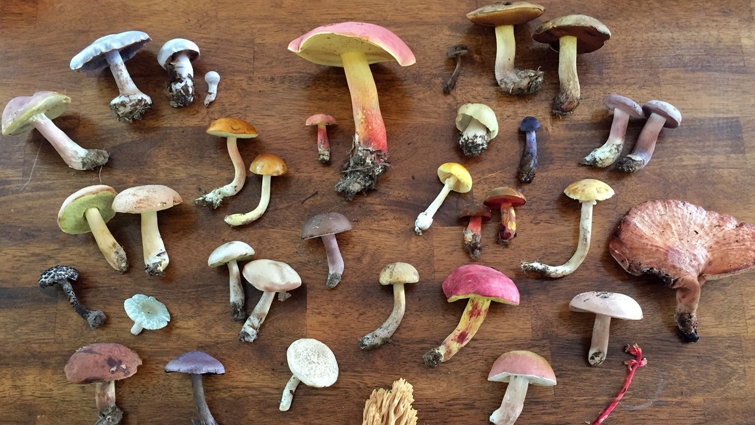
Synoptic Key of Life II
La Monte Yarroll
David Caspers
Christopher Murphy
IST 718: Big Data Analytics
March 2025
National Park Service, Sarah Daughterty

Slide 2
Agenda
Project Overview
Goals
Exploring the Data
Methods
Results
Challenges & Learnings

Slide 3
Project Overview
Establish a centralized repository for mushroom classification data and allow researchers to identify mushrooms based on their features.
Automated parsing of journal text into discrete paragraphs
Identification of paragraphs defining species names (nomenclatures) and species descriptions via classification
Removing extraneous paragraphs
Create streamlined “taxon” object of nomenclature and description
Embed “taxon” content into semantic search application

Slide 4
System Components and Process Flow
SKOL Part I
01
02
03
04
05
06
PySpark Automation
Parse
Classify
Remove
Extraneous
content
Generate
Taxon
* Embed
Taxon
Content
In Search
* Provide
Semantic
Search
Interface
SKOL Part II
* Pre-existing search application provided
by the Auton Lab at Carnagie Mellon University

Slide 5
Goals
Prediction & Inference:
Train multiple classification algorithms based on manually-labeled journal paragraphs.
Identify a classification approach with acceptable accuracy.
Other Goals:
Automate text parsing & categorization for thousands of journals.
Streamline taxonomic analysis by automating classification.
Enable rapid fungal species identification through descriptive search.
Advance Mycological research through faster, more consistent species identification

Slide 6
The Data
The labeled corpus was parsed to extract paragraph categories and maintain their structure.
For the unlabeled OCR corpus, we applied heuristic rules to segment paragraphs.
Corpus | Description | Paragraph Categories | Words | Lines
Labeled | 190 journal issues (manually annotated) | 6,072 Nomenclatures 6,192 Descriptions 48,564 Exposition | 2,123,285 | 301,874
Unlabeled | 1,021 journal issues (primarily OCR processed PDFs) | Raw text requiring classification and annotation | 25,552,432 | 4,272,880

Slide 7

Methods
The following section outlines approaches for heuristic parsing of journals and classification of the paragraphs.

Slide 8


Methods
Heuristic Processing of Raw Journal Articles:
Specific rules are defined based upon observed conventions, patterns and paragraph structural cues (such as line breaks, indentation, special keywords, or formatting elements).
Processing Logic:
Import files (with unique id)
Group by file name
Apply paragraph extractor UDF
Explode each paragraph to separate row
Remove interstitial paragraphs

Slide 9
Methods
Classification of Paragraphs
Annotated documents are parsed
Labelled paragraphs are aggregated into a dataframe
A PySpark pipeline is used to calculate TFIDF values for text features of each paragraph
Train and Test dataframes are created (80 / 20 split)
Pipelines are used to train classification models
Logistic Regression
Random Forest
PCA was attempted

Slide 10
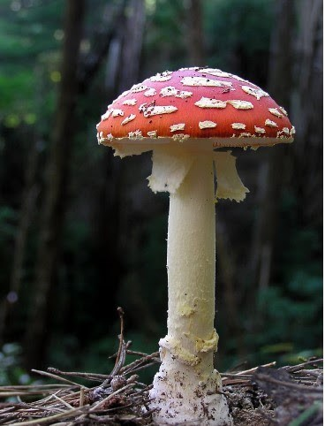
Results
The following section outlines results
Tony Wills, CC BY SA 3.0

Slide 11
Model Performance
Best Model: Logistic Regression words and suffix features
Strong Baseline: Logistic Regression with words
Surprisingly Effective: Logistic regression with suffix features show morphological patterns help classification.
Weak Performance: Random Forest. Results could indicate overfitting in this model.
Model | Data | Accuracy | Precision | Recall | F1 Score
Logistic Regression | Word Features (TFIDF) | 0.9418 | 0.9603 | 0.9666 | 0.9414
Logistic Regression | Suffix Features Only (TFIDF) | 0.9396 | 0.9593 | 0.9649 | 0.9392
Logistic Regression | Word and Suffix Features | 0.9421 | 0.9640 | 0.9630 | 0.9419
Random Forest | Words | 0.7878 | 0.7878 | 1.000 | 0.9643

Slide 12

Challenges & Mitigations
The following section outlines problems encountered, mitigations, and lessons learned

Slide 13
Principle Component Analysis Failed
TF-IDF created over 20,000 dimensions, making PCA infeasible, leading to increased processing time and complexity.
Running Spark in Google Colab limited its performance benefits, reducing efficiency in handling large datasets.
Mitigations:
Paused attempts to complete PCA.
Re-purposed our available time to test the effect of suffixes on classification.

Slide 14
Journal Article Organization & OCR errors
In Journal articles, species descriptions do not always follow immediately after species nomenclatures.
OCR errors can cause fragmented text.
Mitigations:
Reduced noise using TF-IDF weighting for taxonomic terms
Removed common uninformative words
Extracted species suffixes to aid in differentiation from description paragraphs

Slide 15
Text Ordering in PySpark
Maintaining document structure was challenging due to Spark’s distributed nature, requiring extra steps to group and align text properly.
Mitigations:
Indexes and line identifiers were added to keep track of ordering and positioning of text in source documents.

Slide 16
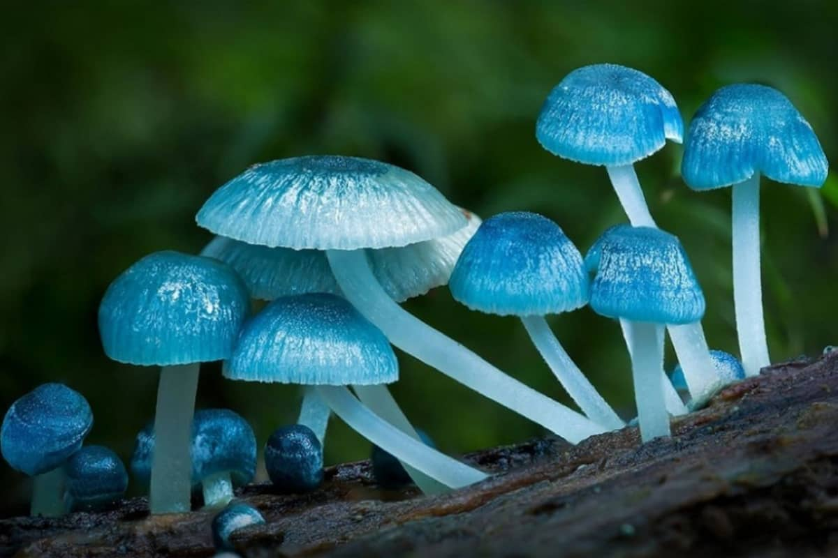
Thank you
garthsmithphotography.com

